Slide 1
أكـــــاديميــــة طــــويـــق
Linear Algebra for Machine Learning

Slide 2
Introduction to Linear Algebra
Fundamentals and Applications
By: Dr. Afshan Hashmi

Slide 3
Course Objectives:
Recall and explain the relationship between machine learning concepts and mathematical constructs like vectors and matrices.
Course Learning Outcomes:
Demonstrate a comprehensive understanding of key mathematical concepts, including linear algebra and probability, and their applications in AI and machine learning.

Slide 4
Learning Objectives
Identify matrices as operators
Relate the transformation matrix to a set of new basis vectors
Formulate code for mappings based on these transformation matrices
Write code to find an orthonormal basis set computationally

Slide 5


Understanding Matrices as Operators
Matrices are not just arrays of numbers; they serve as powerful mathematical operators that transform vectors and spaces. Understanding matrices as operators helps in fields such as physics, computer graphics, and engineering.
1. What are Matrices as Operators?
A matrix can be viewed as an operator that maps an input vector to an output vector via multiplication. This transformation can involve:
Scaling
Rotation
Reflection
Shearing
Projection
For a given matrix A and vector v : $A ∗ v = v^{′}$
Where is the transformed vector.

Slide 6
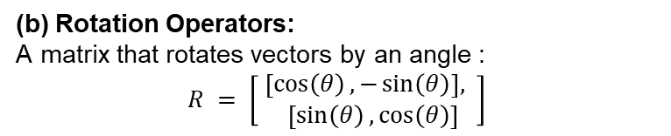
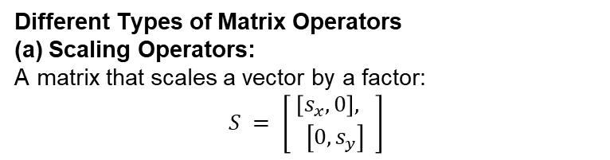
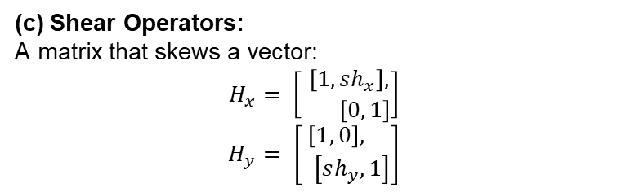
Matrices as Transformations
Different Types of Matrix Operators
(a) Scaling Operators:
A matrix that scales a vector by a factor:
$$S = \left[\begin{aligned} \left[s_{x}, 0\right], \\ \left[0, s_{y}\right]\end{aligned}\right]$$
(b) Rotation Operators:
A matrix that rotates vectors by an angle :
$$R = \left[\begin{aligned} \left[\cos\left(θ\right), −\sin\left(θ\right)\right], \\ \left[\sin\left(θ\right),\cos\left(θ\right)\right]\end{aligned}\right]$$
(c) Shear Operators:
A matrix that skews a vector:
$$H_{x}= \left[\begin{aligned} \left[1, sh_{x}\right], \\ \left[0, 1\right]\end{aligned}\right]$$
$$H_{y}= \left[\begin{aligned} \left[1, 0\right], \\ \left[sh_{y}, 1\right]\end{aligned}\right]$$

Slide 7
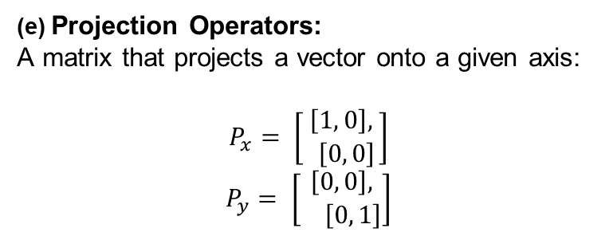
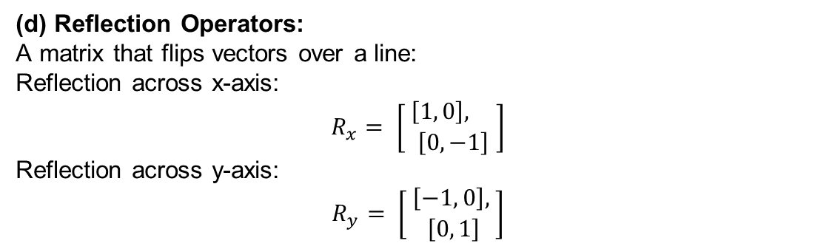
Matrices as Transformations
(d) Reflection Operators:
A matrix that flips vectors over a line:
Reflection across x-axis:
$$R_{x}= \left[\begin{aligned} \left[1, 0\right], \\ \left[0, −1\right]\end{aligned}\right]$$
Reflection across y-axis:
$$R_{y}= \left[\begin{aligned} \left[−1, 0\right], \\ \left[0, 1\right]\end{aligned}\right]$$
(e) Projection Operators:
A matrix that projects a vector onto a given axis:
$$P_{x}= \left[\begin{aligned} \left[1, 0\right], \\ \left[0, 0\right]\end{aligned}\right]$$
$$P_{y}= \left[\begin{aligned} \left[0, 0\right], \\ \left[0, 1\right]\end{aligned}\right]$$

Slide 8
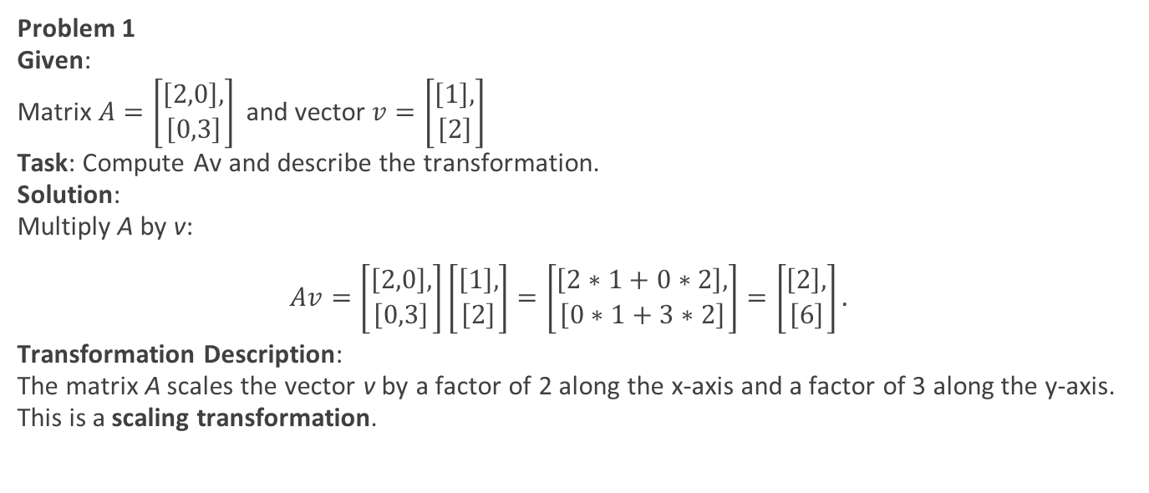
Practice Problems
Problem 1
Given:
Matrix $A=\left[\begin{aligned}\left[2,0\right], \\ \left[0,3\right]\end{aligned}\right]$and vector$v=\left[\begin{aligned}\left[1\right], \\ \left[2\right]\end{aligned}\right]$
Task: Compute Av and describe the transformation.
Solution:
Multiply A by v:
$$Av=\left[\begin{aligned}\left[2,0\right], \\ \left[0,3\right]\end{aligned}\right]\left[\begin{aligned}\left[1\right], \\ \left[2\right]\end{aligned}\right]=\left[\begin{aligned}\left[2∗1+0∗2\right], \\ \left[0∗1+3∗2\right]\end{aligned}\right]=\left[\begin{aligned}\left[2\right], \\ \left[6\right]\end{aligned}\right].$$
Transformation Description:
The matrix A scales the vector v by a factor of 2 along the x-axis and a factor of 3 along the y-axis. This is a scaling transformation.

Slide 9
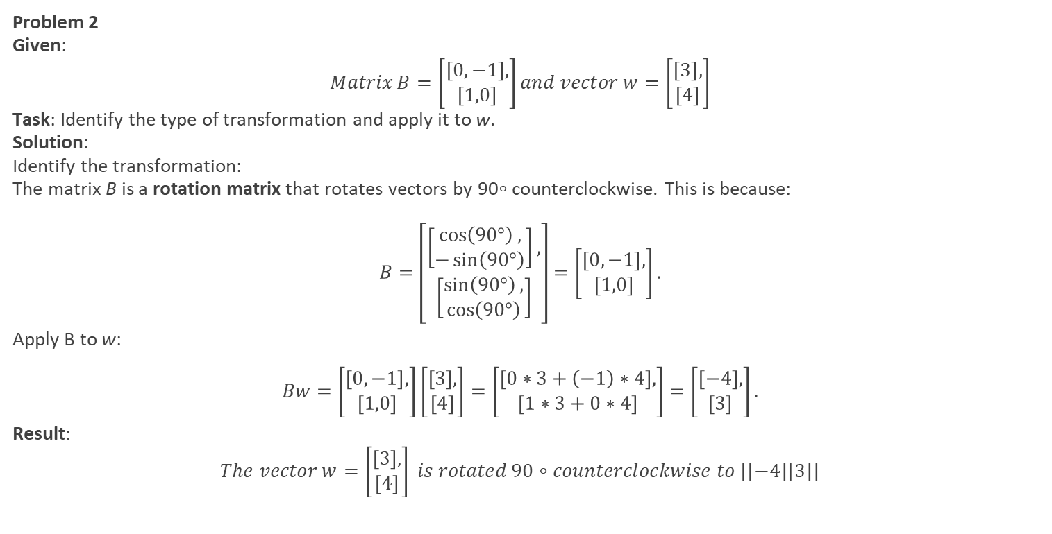
Practice Problems
Problem 2
Given:
$$Matrix B=\left[\begin{aligned}\left[0,−1\right], \\ \left[1,0\right]\end{aligned}\right]and vector w=\left[\begin{aligned}\left[3\right], \\ \left[4\right]\end{aligned}\right]$$
Task: Identify the type of transformation and apply it to w.
Solution:
Identify the transformation:
The matrix B is a rotation matrix that rotates vectors by 90∘ counterclockwise. This is because:
$$B=\left[\begin{aligned}\left[\begin{aligned}\cos\left(90°\right), \\ −\sin\left(90°\right)\end{aligned}\right], \\ \left[\begin{aligned}\sin\left(90°\right), \\ \cos\left(90°\right)\end{aligned}\right]\end{aligned}\right]=\left[\begin{aligned}\left[0,−1\right], \\ \left[1,0\right]\end{aligned}\right].$$
Apply B to w:
$$Bw=\left[\begin{aligned}\left[0,−1\right], \\ \left[1,0\right]\end{aligned}\right]\left[\begin{aligned}\left[3\right], \\ \left[4\right]\end{aligned}\right]=\left[\begin{aligned}\left[0∗3+\left(−1\right)∗4\right], \\ \left[1∗3+0∗4\right]\end{aligned}\right]=\left[\begin{aligned}\left[−4\right], \\ \left[3\right]\end{aligned}\right].$$
Result:
$$The vector w=\left[\begin{aligned}\left[3\right], \\ \left[4\right]\end{aligned}\right] is rotated 90∘counterclockwise to [[−4][3]]$$

Slide 10
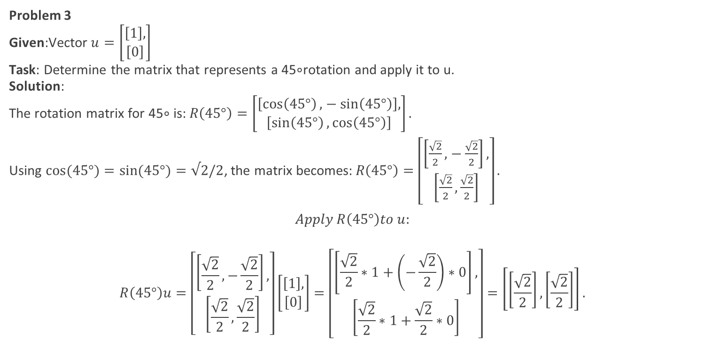
Practice Problems
Problem 3
Given:Vector $u=\left[\begin{aligned}\left[1\right], \\ \left[0\right]\end{aligned}\right]$
Task: Determine the matrix that represents a 45∘rotation and apply it to u.
Solution:
The rotation matrix for 45∘ is:$R\left(45°\right)=\left[\begin{aligned}\left[\cos\left(45°\right),−\sin\left(45°\right)\right], \\ \left[\sin\left(45°\right),\cos\left(45°\right)\right]\end{aligned}\right].$
Using $cos⁡(45°)=sin⁡(45°)=√2/2$, the matrix becomes:$R\left(45°\right)=\left[\begin{aligned}\left[\frac{\sqrt{2}}{2},−\frac{\sqrt{2}}{2}\right], \\ \left[\frac{\sqrt{2}}{2},\frac{\sqrt{2}}{2}\right]\end{aligned}\right].$
$$Apply R\left(45°\right)to u:$$
$$R\left(45°\right)u=\left[\begin{aligned}\left[\frac{\sqrt{2}}{2},−\frac{\sqrt{2}}{2}\right], \\ \left[\frac{\sqrt{2}}{2},\frac{\sqrt{2}}{2}\right]\end{aligned}\right]\left[\begin{aligned}\left[1\right], \\ \left[0\right]\end{aligned}\right]=\left[\begin{aligned}\left[\frac{\sqrt{2}}{2}∗1+\left(−\frac{\sqrt{2}}{2}\right)∗0\right], \\ \left[\frac{\sqrt{2}}{2}∗1+\frac{\sqrt{2}}{2}∗0\right]\end{aligned}\right]=\left[\left[\frac{\sqrt{2}}{2}\right],\left[\frac{\sqrt{2}}{2}\right]\right].$$

Slide 11
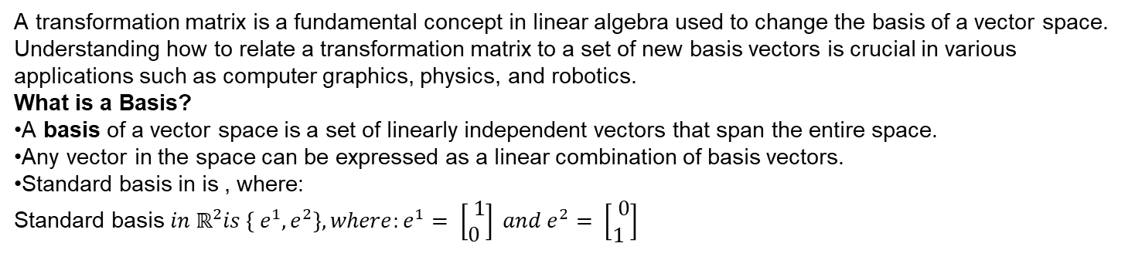
Relating the Transformation Matrix to a Set of New Basis Vectors
A transformation matrix is a fundamental concept in linear algebra used to change the basis of a vector space. Understanding how to relate a transformation matrix to a set of new basis vectors is crucial in various applications such as computer graphics, physics, and robotics.
What is a Basis?
A basis of a vector space is a set of linearly independent vectors that span the entire space.
Any vector in the space can be expressed as a linear combination of basis vectors.
Standard basis in is , where:
Standard basis $in ℝ^{2}is \left\{ e^{1}, e^{2}\right\}, where:e^{1}= \left[\begin{aligned} 1 \\ 0 \end{aligned}\right] and e^{2}= \left[\begin{aligned} 0 \\ 1 \end{aligned}\right]$

Slide 12
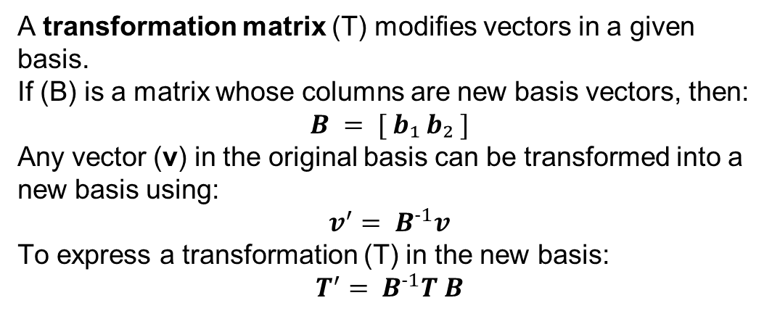
Transformation Matrices and Basis Change
A transformation matrix (T) modifies vectors in a given basis.
If (B) is a matrix whose columns are new basis vectors, then:
$$B = [ b₁ b₂ ]$$
Any vector (v) in the original basis can be transformed into a new basis using:
$$v^{′}= B^{-1}v$$
To express a transformation (T) in the new basis:
$$T^{′}= B^{-1}T B$$

Slide 13
References
Strang, G. (2016). Introduction to Linear Algebra. Wellesley-Cambridge Press.
NumPy Documentation: https://numpy.org/doc/
Matplotlib Guide: https://matplotlib.org/stable/contents.html

Slide 14

















الشراكات العالمية

Slide 15
شــــــكــــرًا لكــــــم
THANK YOU

